Slide 1
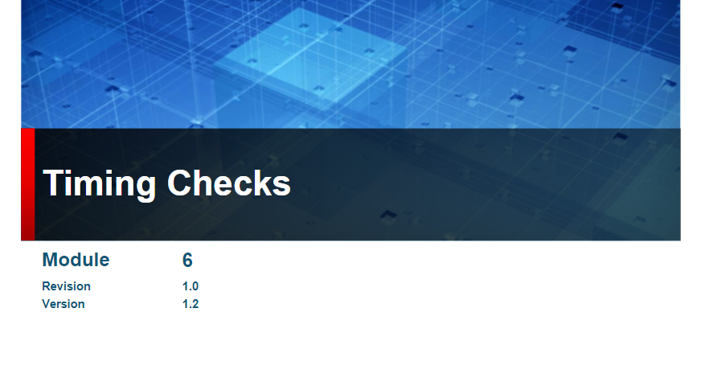

Slide 2
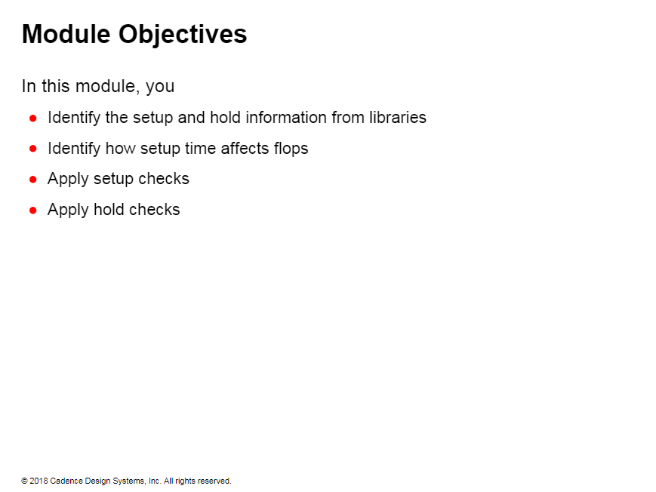

Slide 3
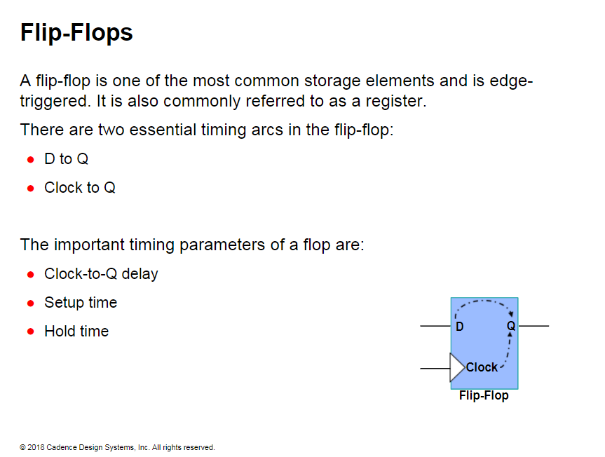
Notes:
The important thing to remember in an edge-triggered flop is that the input is propagated to the output only when the active clock edge is triggered.
Therefore. all timing is calculated from the clock edge, and the clock-to-Q delay is used in timing.
In an edge-triggered flop, the STA tools use clock-to-Q delay instead of D-to-Q delay, because the data has to wait for the clock edge to arrive.
Therefore, delays from a flip- flop are calculated from the clock edge.

Slide 4
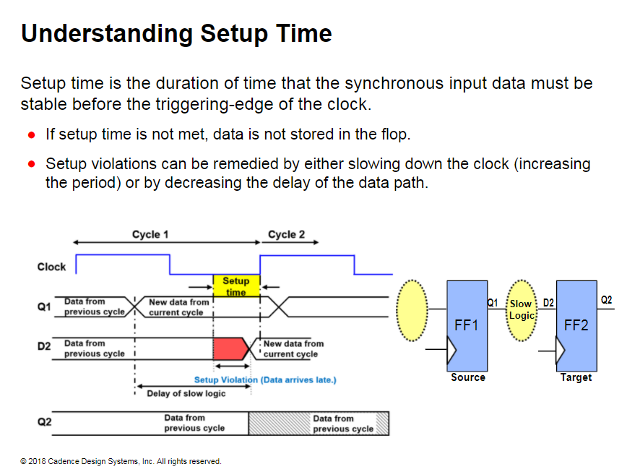
Notes:
In this illustration, because of the slow logic, the D2 input is delayed. Therefore, the data does not change from the old value to the new value until it is too late. Before the capture clock edge arrives, the data must be stable for the entire duration of the setup time. Because the D2 input changes value within the duration of the setup time, you have a setup violation. Therefore, the new data will not be stored in the target flop.

Slide 5
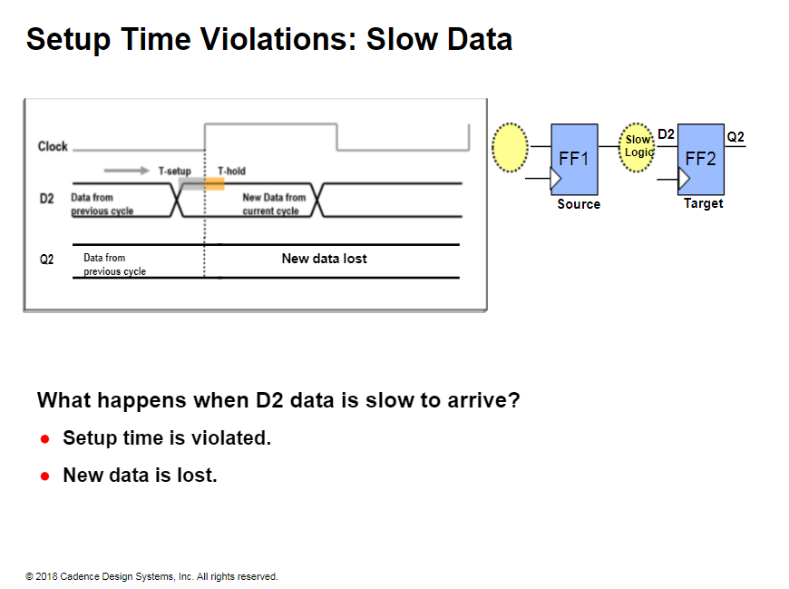

Slide 6
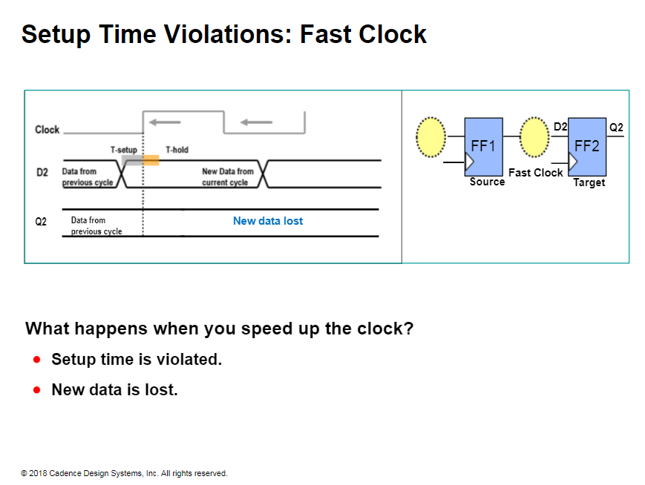

Slide 7
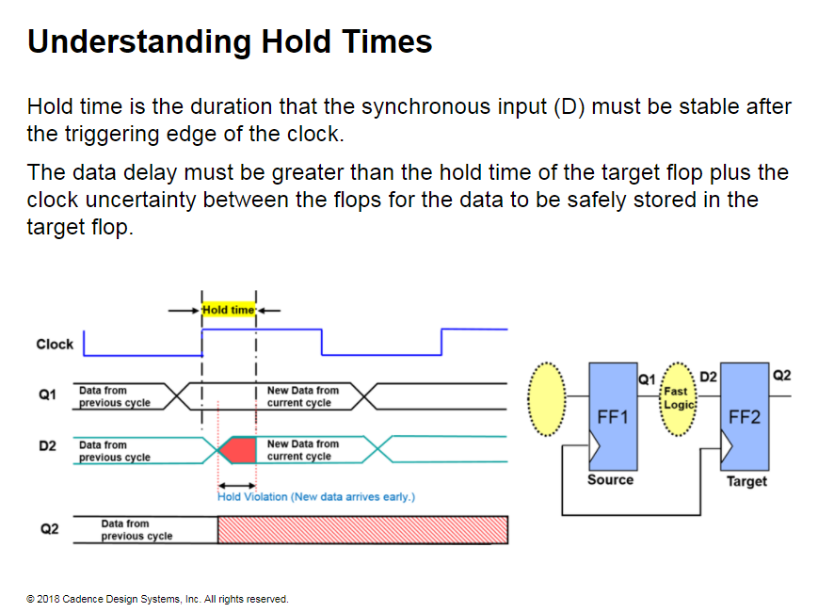
Notes:
You can correct hold violations by
increasing the delay of the data path or by decreasing the clock uncertainty if specified in the design. For this reason, designers try to reduce the amount of skew in the clock trees.
For properly constrained clock trees, there will not be any hold violations.
In this illustration, the D2 input immediately changes value from the old data to the new data because of the fast logic.
After the capture clock edge arrives. the data must be stable for the entire duration of the hold time.
Because the D2 input changes within the duration of the hold time, you will have a hold violation. Therefore. the old data will not be stored in the target flop.

Slide 8
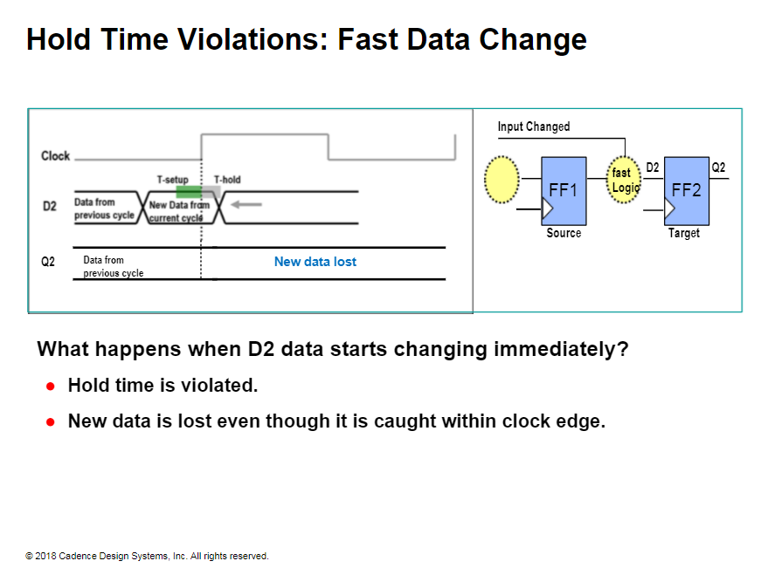

Slide 9
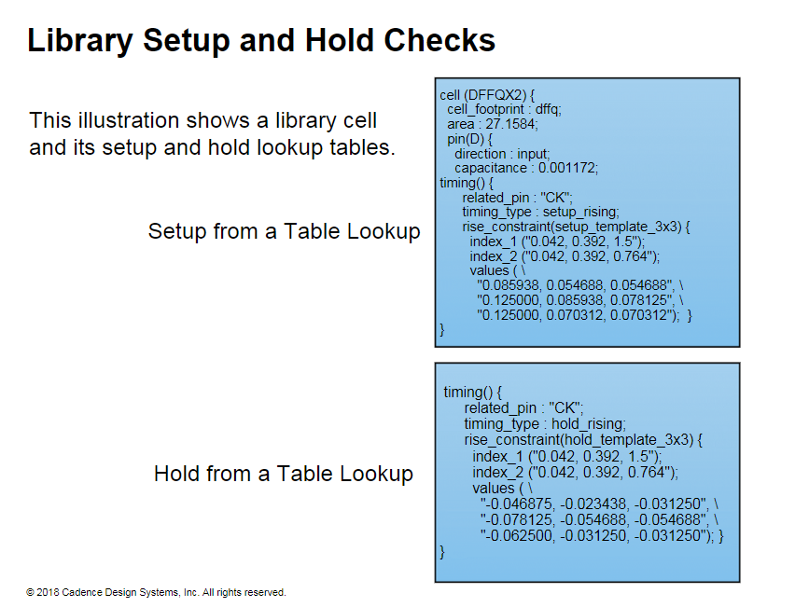
Notes:
The example shows the .lib cell model for a D flip-flop. The values of the hold and the setup are on the D-input pin.
For a given set of load and skew conditions for the flop. notice the following:
The setup time varies from 0.054668 to 0.125.
The hold times are negative.

Slide 10
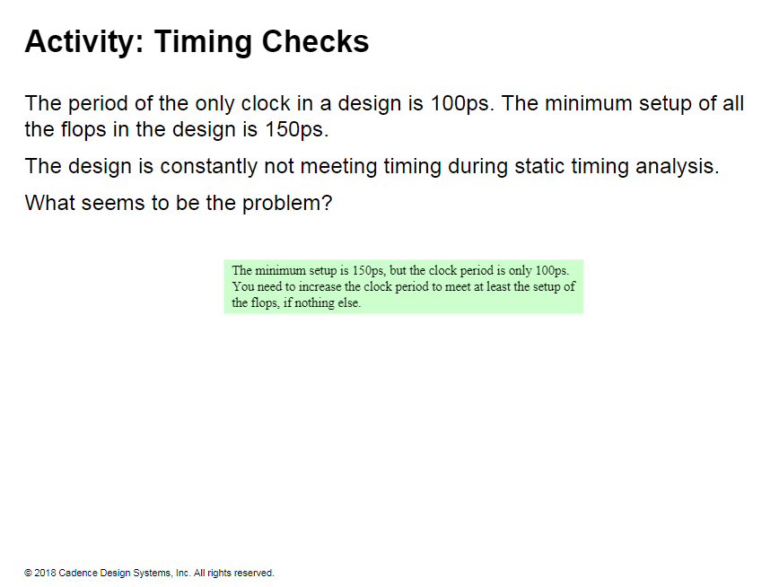

Slide 11
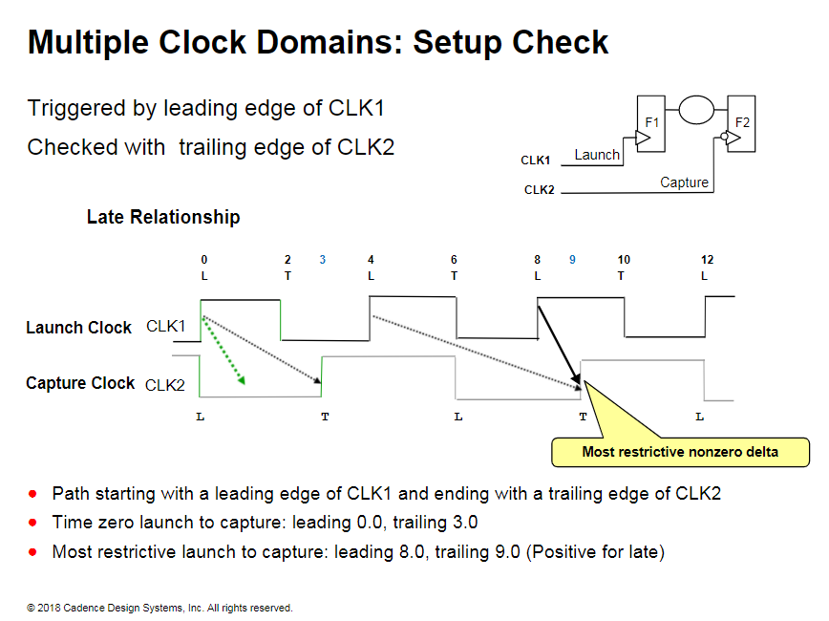

Slide 12
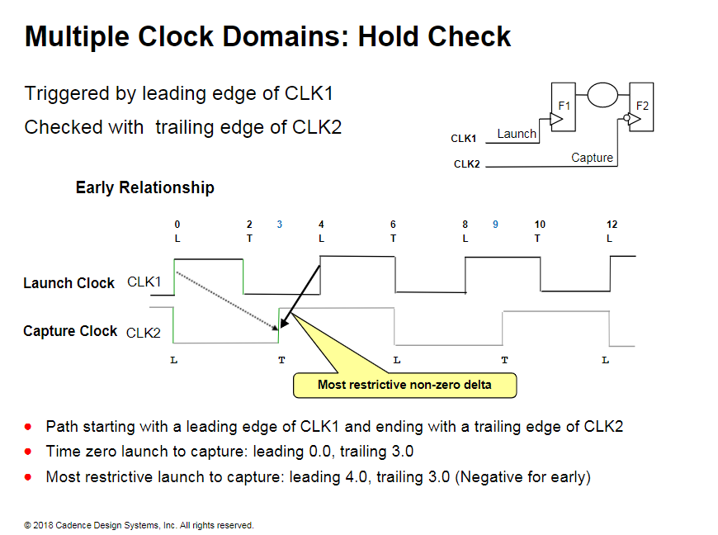

Slide 13
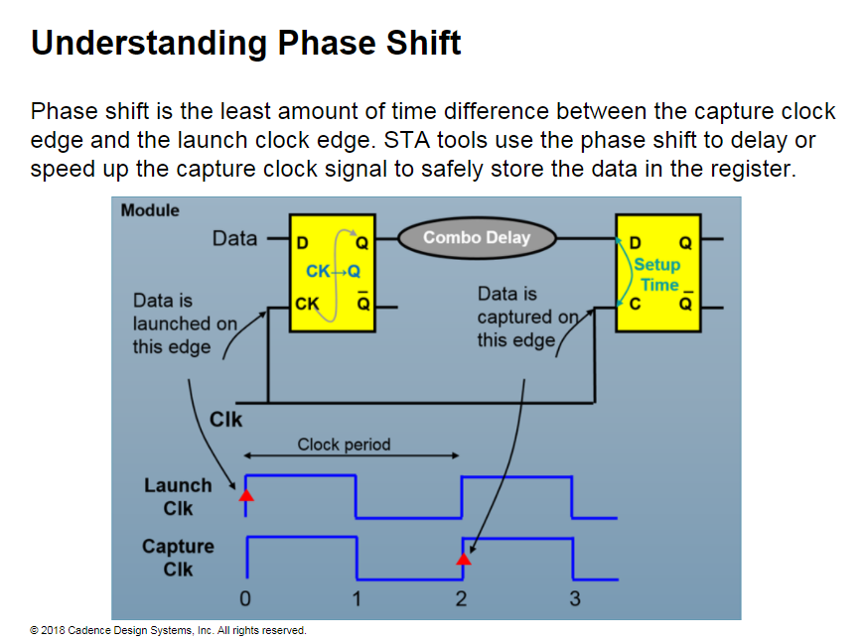
Notes:
Phase shift occurs when the launch clock edge and capture clock edge have a phase difference, because the waveform of the clock is shifted at the capture clock.
For example. if a positive edge is used for the launch and a negative edge for the capture. some tools report the phase shift to be half a clock period for a clock duty cycle of 50%.
Reporting Phase Shift
For paths as shown in the above single-clock illustration, you might see some differences in the way phase shift is reported in different tools.
Some tools report what edge is launching and capturing, and also report a zero phase shift.
Some tools use a phase shift of one clock period and report it as phase shift. STA tools report the phase shift in the required time section of a timing report. So it is easy to locate phase shift regardless of what tool it is reported by.
In this course, we will follow the zero phase shift reporting mechanism for same-clock paths.

Slide 14
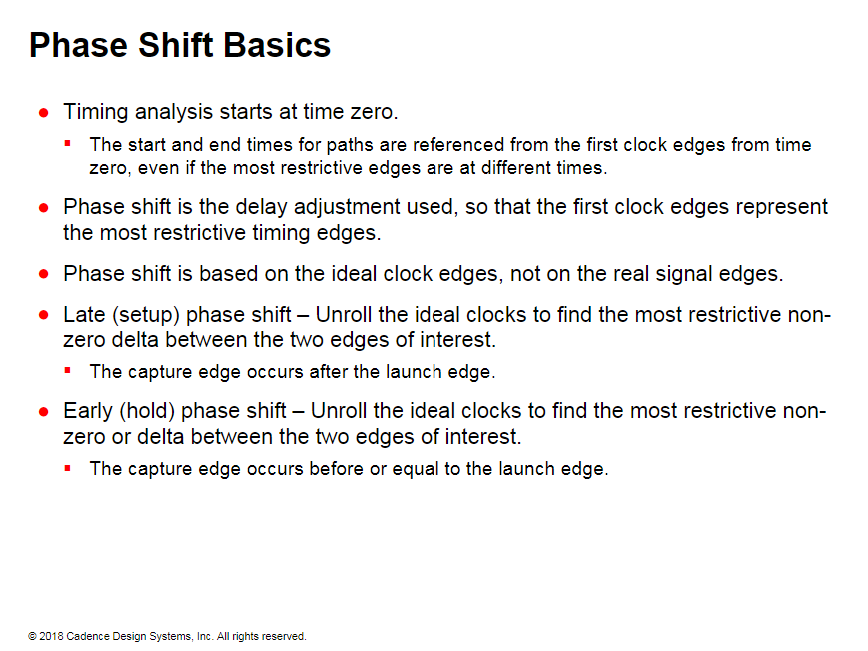
Notes:
Every data signal has an associated ideal clock from which arrival time and required time are referenced. The arrival time is referenced from the launching clock edge and required time is referenced from the capturing clock edge.
Phase shift is the delay adjustment used to calculate the appropriate required time at the path end point.
For the same timing path, phase shift is different between late mode (setup check) and early mode (hold check).
In the setup check, the capturing edge that occurs after and closest to the launching edge is used as checking edge
In hold check, the capturing edge that occurs on or before — closest to — the launching edge is used as the checking edge.
The phase shift is non- zero when the checking edge does not align with the appropriate edge of the ideal clock..

Slide 15
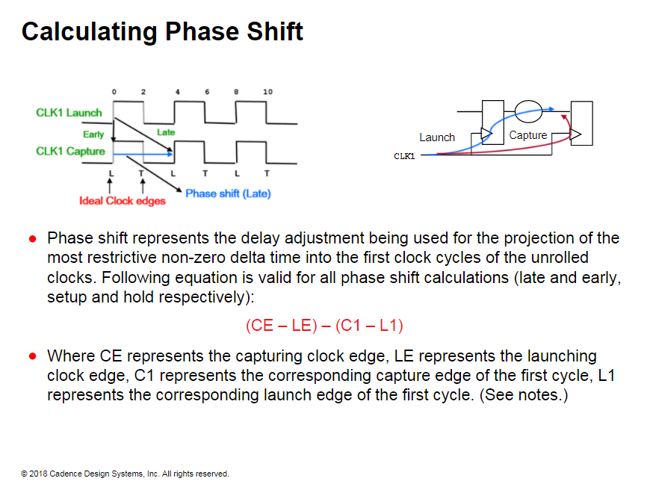
Notes:
Unroll the ideal clock waveforms of the launching and the capturing clocks until both leading edges align.
Identify the correct checking edge by selecting the closest capturing edge that occurs for the launching edge for the late (setup) or early (hold) modes, as applicable.
Phase shift for late (setup check) is calculated as follows:
Most restrictive launch edge to capture edge ideal times: 0 and 4 respectively. Setup phase shift: (4 -0)- (0-0) =4.0
Phase shift for earls (hold check) is calculated as follows:
Most restrictive launch edge to capture edge ideal times: 0 and 0 respectively. Hold phase shift: (0-0)- (0-0) =0.0

Slide 16
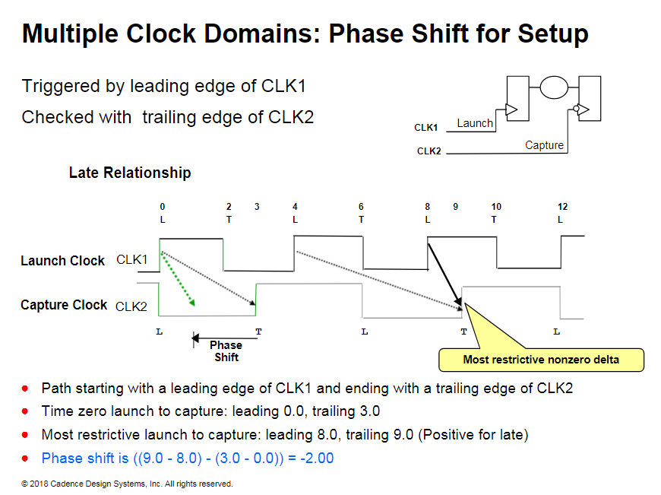
Notes:
Phase shift for late (setup check) is calculated the following way:
Launch edge is at 8 while the first clock edge (lead) is at 0.
Capture edge is at 9 while the first clock edge (trail) is at 3. Remember that a negative-edge clock starts with the falling edge.
Phase shift is calculated as:
Least restrictive edge adjustment - first clock edge adjustment: ((9 - 8) - (3 -0))=-2

Slide 17
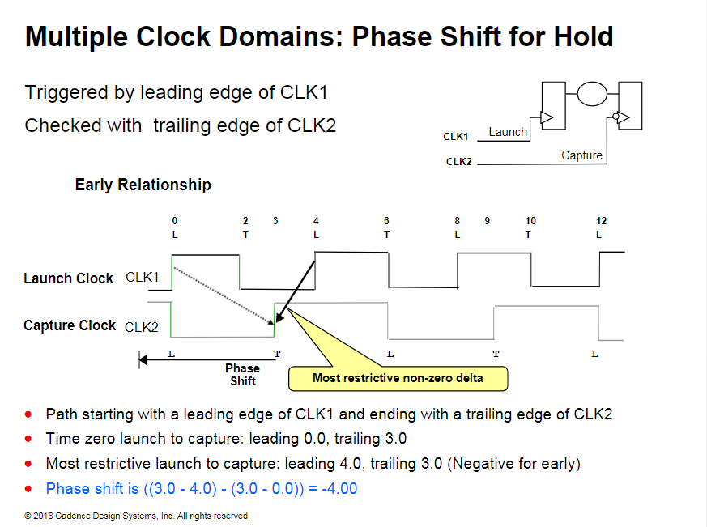

Slide 18
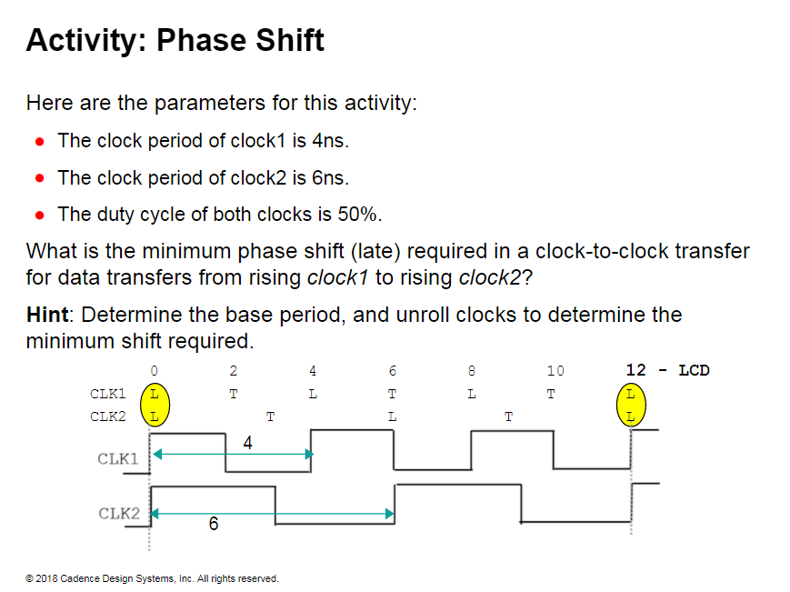

Slide 19
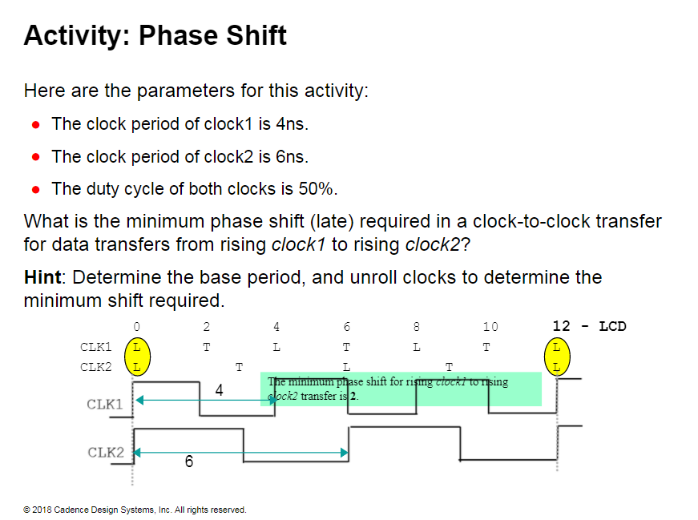

Slide 20
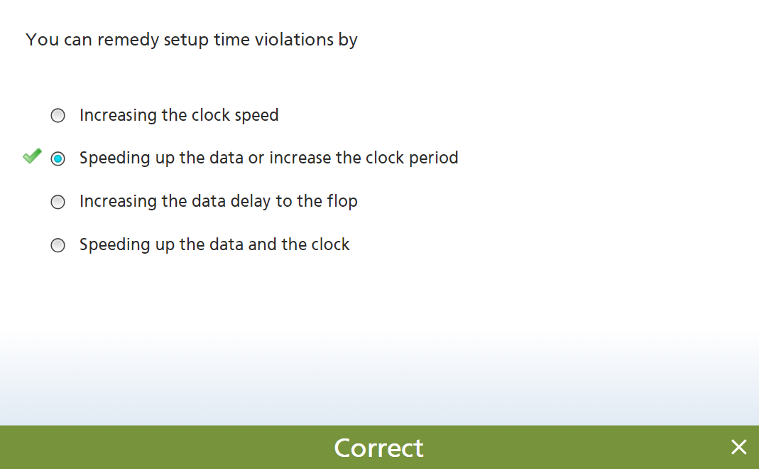

Slide 21
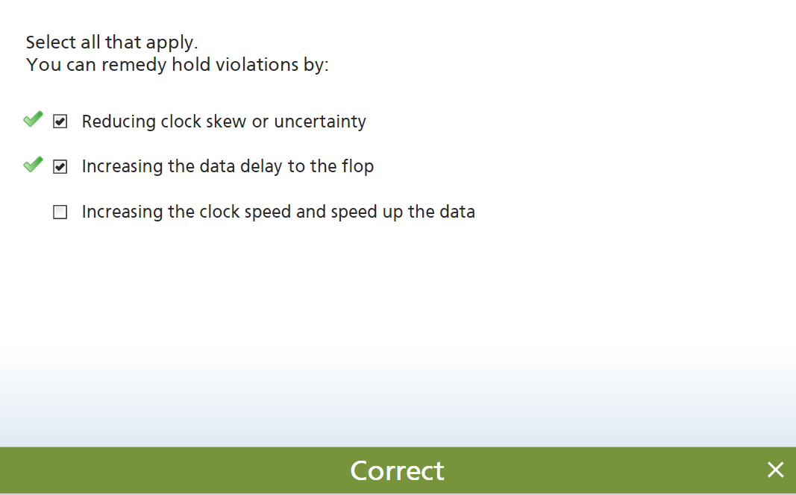

Slide 22
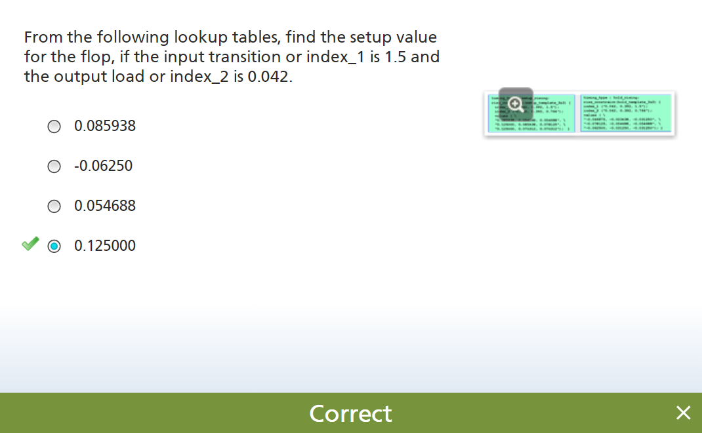

Slide 23
